Slide 1
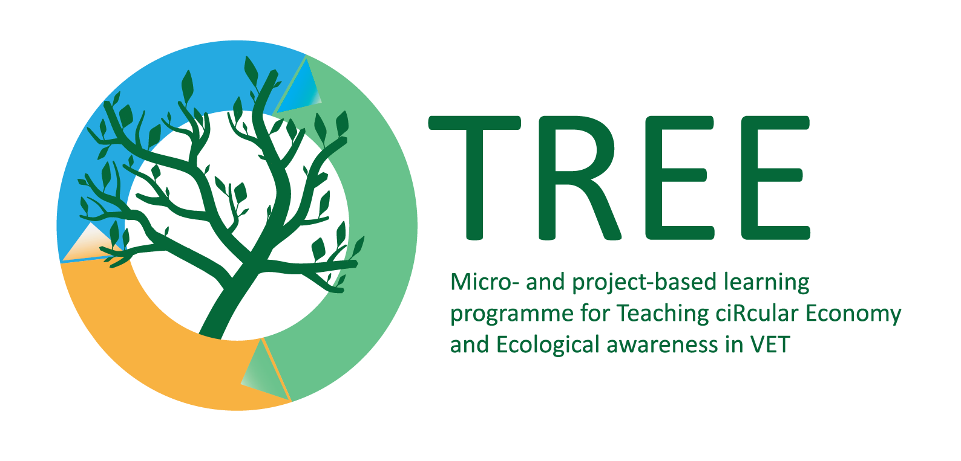
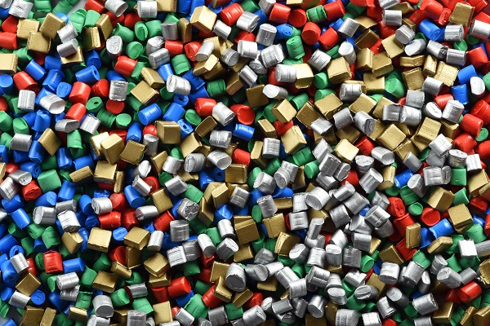
Effects of microplastics on organisms
Photo by google.com: https://images.app.goo.gl/3LWh5ScMaGNYKC1b6
Keywords : microplastic , BPA, phthalate
The European Commission's support for the production of this publication does not constitute an endorsement of the contents, which reflect the views only of the authors, and the Commission cannot be held responsible for any use which may be made of the information contained therein.

Slide 2
Definitions
Plastic , plastic − polymeric material from which products are formed when it is plastic;
https://www.britannica.com/science/plastic
Primary microplastics are produced as small particles that could perform a specific function;
https://education.nationalgeographic.org/resource/microplastics
Secondary microplastics come from the breakdown of larger plastic items.
https://education.nationalgeographic.org/resource/microplastics
BPA - bisphenol , one of the components used in the production of plastic A
https://www.sigmaaldrich.com/LT/en/product/aldrich/239658?gclid=Cj0KCQjw1vSZBhDuARIsAKZlijSPnXsS7P692Grlp169-rhbHhKJcUVJxFZbDwQL9oVUVLw5H4S0Vz8aAhHNEALw_wcB&gclsrc=aw.ds
Phthalate - harmful plastic used in the production of toys.
https://eeb.org/toxictoys/

Slide 3
Learning outcomes
Using various sources, students will be able to indicate the effects of microplastics on organisms;
They will describe the need and possibilities of plastic;
Students will indicate the effect of microplastics on the body;
They will offer an alternative to plastic products.

Slide 4
Green skill (s) addressed
Forward-thinking
Analytical skills
Lean production
Maintenance and repair skills
Pollution prevention
Eco-design
Life-cycle management
Impact quantification
Waste management

Slide 5
Introduction
Micro plastics are solid plastic particles consisting of polymers and active additives.
Micro plastics can form spontaneously when larger plastic products such as car tires or synthetic textile fabrics wear.
Microplastics can also be custom made and added to products with a specific purpose, such as exfoliating granules in face or body scrubs.
Micro plastics used in a variety of products, including fertilizers , plant protection products, cosmetics, household and industrial detergents, cleaning products, paints and products used in the oil and gas industry.
Micro plastics it is also used as a filler for the artificial covering of sports fields.
It is estimated that the EU/EEA uses approximately 145,000 tonnes of microplastics annually.

Slide 6
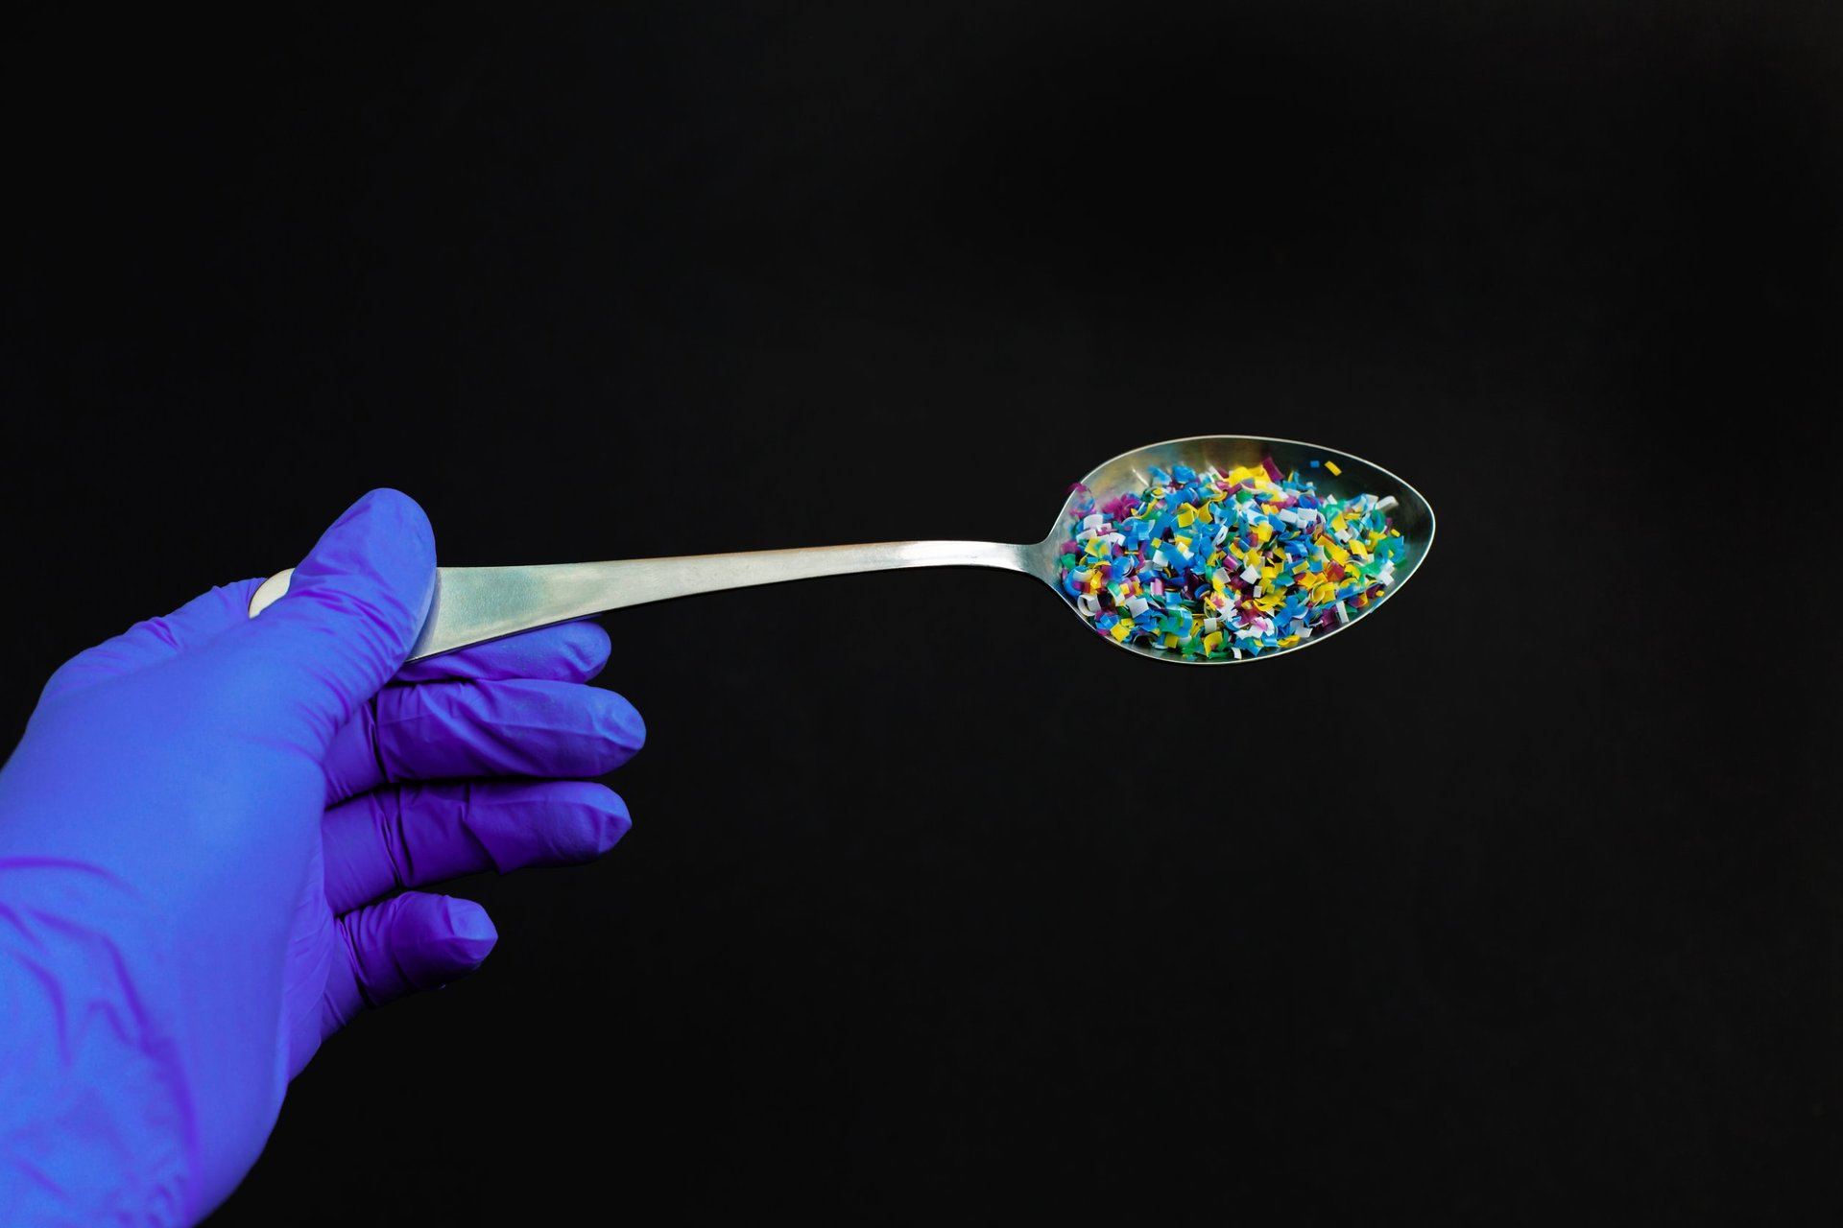
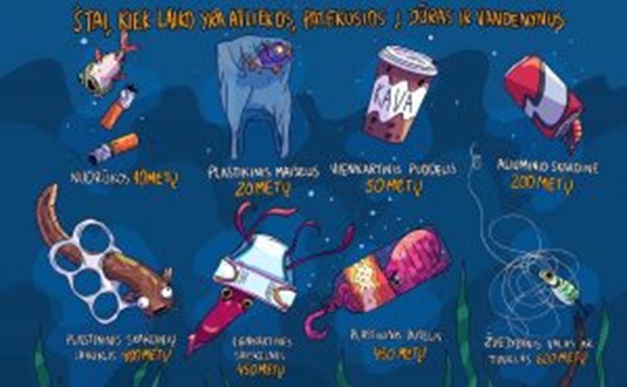
Photo by google.com: https://images.app.goo.gl/KWjzJ5HzWhsHPXgr8 Photo by google.com: https://images.app.goo.gl/Sf48idB7E2mDFQNX9
Introduction

Slide 7
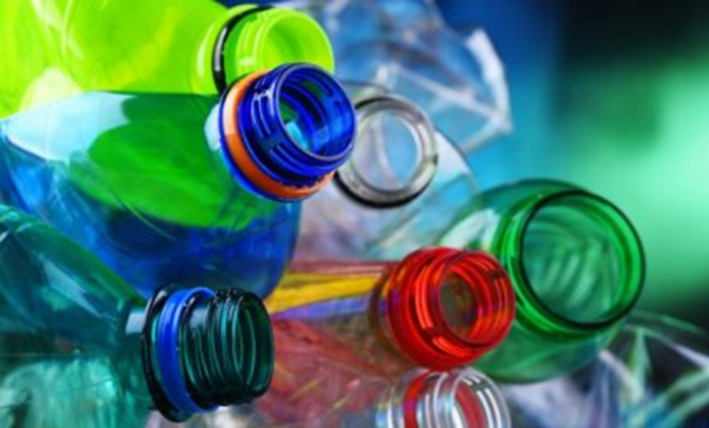
Introduction
Mark the correct answer:
All plastics degrade quickly;
All plastic is toxic;
Degradable plastic is toxic;
Degradable plastic is non-polluting.
Photo by google.com: https://images.app.goo.gl/MZPwMFHn5EXsuVFy6

Slide 8
Introduction : useful links
microplastics , the effects of decomposition on living organisms
https://echa.europa.eu/lt/hot-topics/microplastics
bisphenol A on organisms
https://nmvrvi.lt/bisfenolio-a-itaka-zmoniu-sveikatai/ _ _
phthalates on the body
https:// lt.wikipedia.org/wiki/Plastikas
EU decisions and recommendations
https:// www.europarl.europa.eu/news/lt/headlines/society/20181116STO19217/tarsa-mikroplastiku-saltiniai-poveikis-ir-sprendimai
www.youtube.com/watch?v=49OJoTsZYO0

Slide 9
Introduction : useful links
Reducing the environmental impact of single-use plastics
https://www.youtube.com/watch?v=PfAmozjYUBQ
Single use plastics and discovering the true value of things
https://www.youtube.com/watch?v=y9n-DTARqSQ
The problem with single-use plastic
https://www.youtube.com/watch?v=heLLljcmmNo
The Problem with Plastics
https://www.youtube.com/watch?v=526gMLHDVLg

Slide 10
Topic 1: Classification and use of plastics
Primary microplastics enter the environment directly.
Secondary microplastics are formed by the breakdown of larger plastic items.
Plastic is widely used due to the cheapness of the raw material, good properties and simple product formation.
Appearance, properties and processing characteristics of plastic allow the creation of products of various shapes and finishes.
Plastics are replacing metals in the automotive, appliance, aerospace and other industries.
Porous plastics insulate heat and sound well.
Some plastics are used to make organ prostheses, surgical sutures and adhesives.

Slide 11
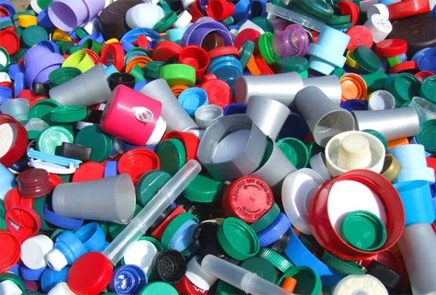
Topic 2: Bisphenol A
an industrial chemical used in the production of artificial materials and artificial resin;
found in plastic products intended for storing or otherwise using various food products (baby bottles, cups, plastic containers, the inner layer of cans );
Acts as a hormone (estrogen)
Photo by google.com:https://images.app.goo.gl/yYF4wvZPKujN5smV8

Slide 12
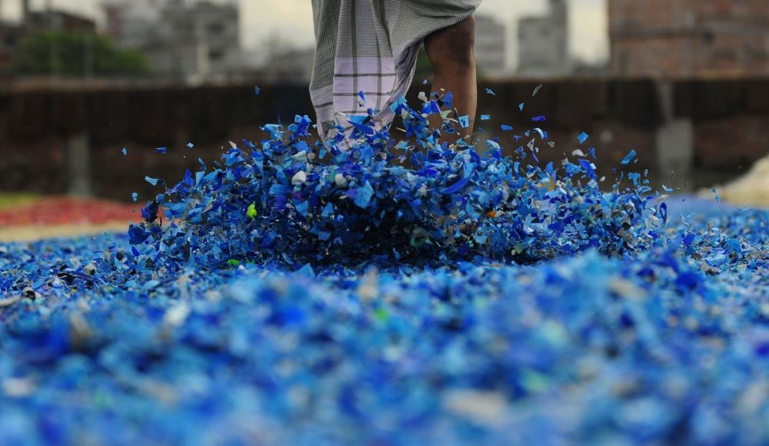
Topic 2: Bisphenol A: questions for reflection
Photo by google.com: https://images.app.goo.gl/nzFLdHyDCVJX8kou6

Slide 13
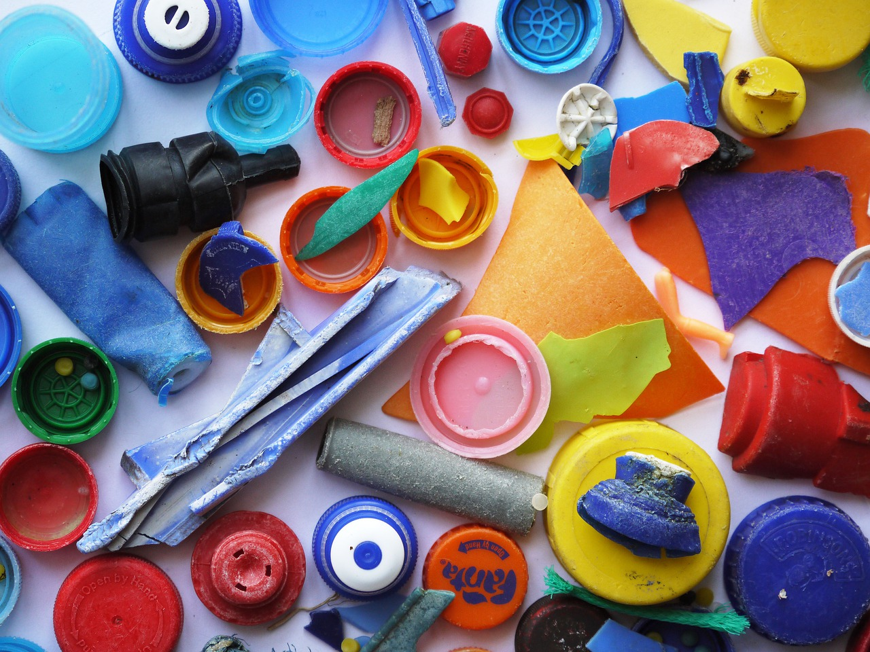
Topic 3: Phthalate
Used for making toys
Very harmful when decomposed
Banned in the EU
Photo by google.com: https://images.app.goo.gl/LBN3G3bTK4sVLe287

Slide 14
Daily habits related
Possible alternatives to single-use plastic:
Disposable straws. They can be made of paper, bamboo or do without them;
Water bottles. You can use reusable dishes - drinking glasses, cups.
Shopping bags. Reusable ones made of different materials can be used.
Cups of coffee. Reusable cups can be used.
Kids toys. It is recommended to buy toys made of organic materials.

Slide 15
Conclusion
When choosing alternative materials - paper, textiles, large amounts of water can be consumed and forests cut down.
The most important thing is to aim for multiple use of any product. A sustainable choice would be to choose not only organically grown raw materials, but also to contribute to saving the resources themselves.
We need to change our thinking, attitude towards consumption.
Not plastic that should be environmentally friendly, but a man.
Plastic has unique properties, we can use it for a long time and recycle it.
It is a material that must be valued and saved.

